Slide 1
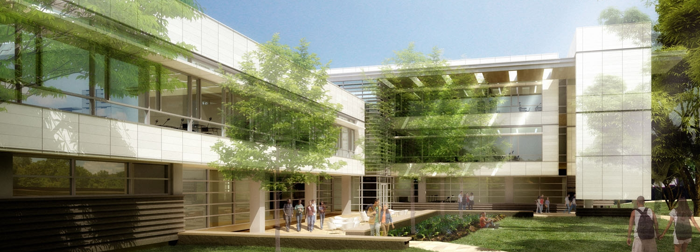
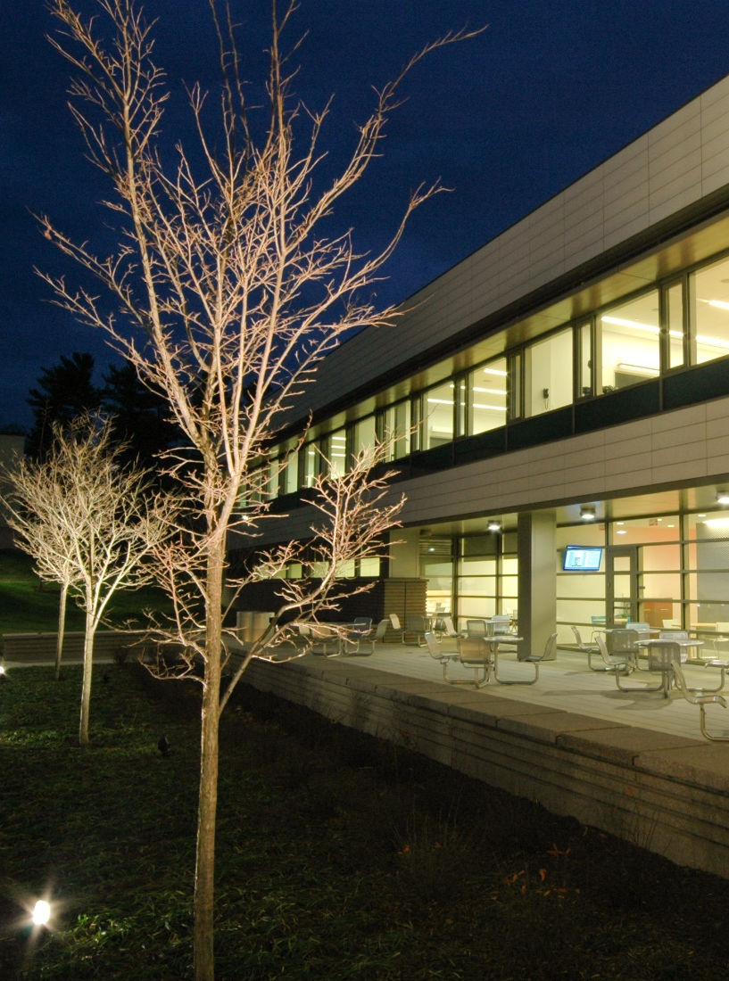
Matthew Neal
Mechanical Option
Dr. Stephen Treado, Adviser

Slide 2

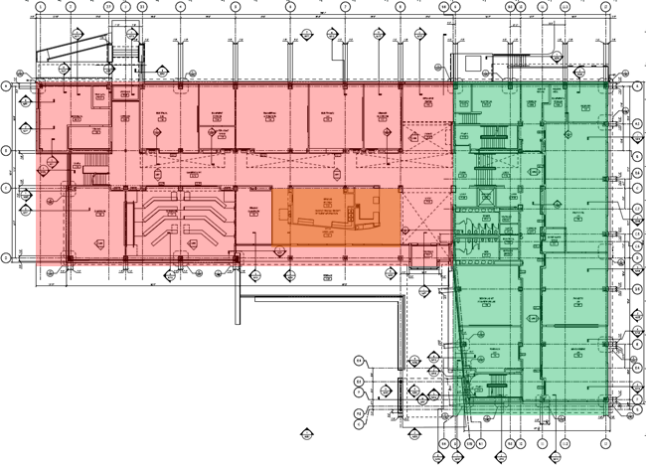
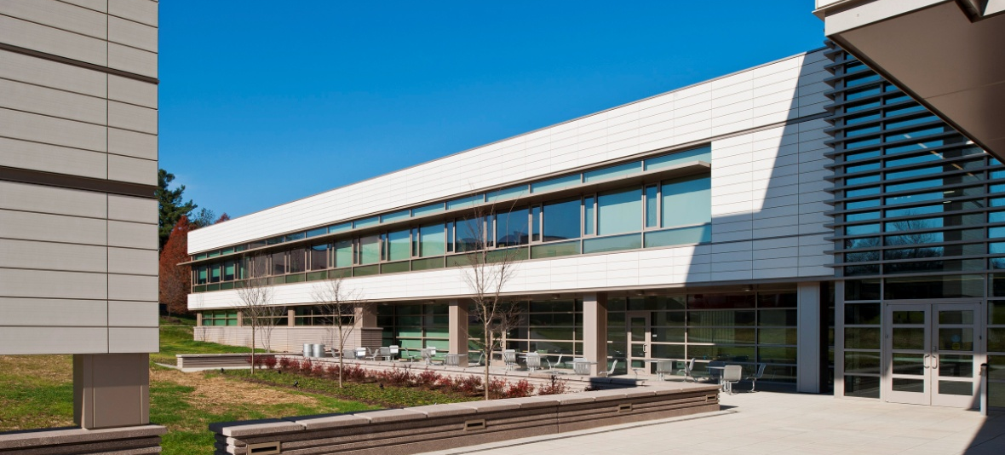
Overview The Gaige Technology and Business Innovation Building
Reading, PA – PSU Berks Campus
Classrooms, Labs and Offices
~ 64,000 SF
Constructed in 2010/2011
$25.7 Million
LEED Gold
Overview
Existing Conditions
Geothermal Depth
System Alternatives
Energy & Emissions
Life Cycle Cost Analysis
Acoustics
Onsite Measurements
Heat Pumps
Campus-wide Geothermal
Conclusions

Slide 3
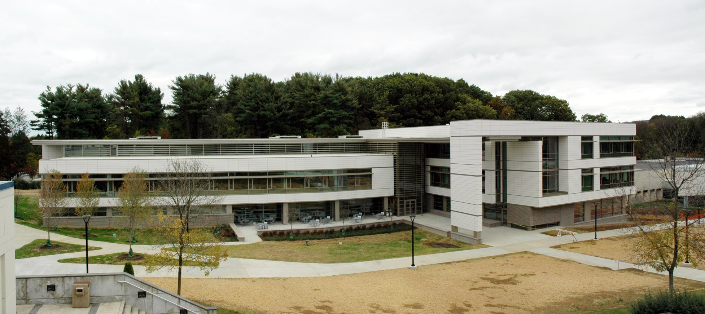
Existing Conditions Mechanical Design
Packaged Roof-Top Units
  VAV with Reheat
  CO₂ and Occupancy Sensors
Fin tube / Radiant Panel Heating
Natural Gas & Electricity Utilities
Overview
Existing Conditions
Geothermal Depth
System Alternatives
Energy & Emissions
Life Cycle Cost Analysis
Acoustics
Onsite Measurements
Heat Pumps
Campus-wide Geothermal
Conclusions

Slide 4

Existing Conditions Energy Model
Initially modeled using Trace 700
  Based on engineer’s model
Overview
Existing Conditions
Geothermal Depth
System Alternatives
Energy & Emissions
Life Cycle Cost Analysis
Acoustics
Onsite Measurements
Heat Pumps
Campus-wide Geothermal
Conclusions

Slide 5
Existing Conditions Energy Model
Initially modeled using Trace 700
  Based on engineer’s model
Compared to Utility Data
Overview
Existing Conditions
Geothermal Depth
System Alternatives
Energy & Emissions
Life Cycle Cost Analysis
Acoustics
Onsite Measurements
Heat Pumps
Campus-wide Geothermal
Conclusions

Slide 6
Existing Conditions Energy Model
Initially modeled using Trace 700
  Based on engineer’s model
Compared to utility data
Validated to utility data
  2.1 % maximum error
Overview
Existing Conditions
Geothermal Depth
System Alternatives
Energy & Emissions
Life Cycle Cost Analysis
Acoustics
Onsite Measurements
Heat Pumps
Campus-wide Geothermal
Conclusions
Actual Consumption

Slide 7
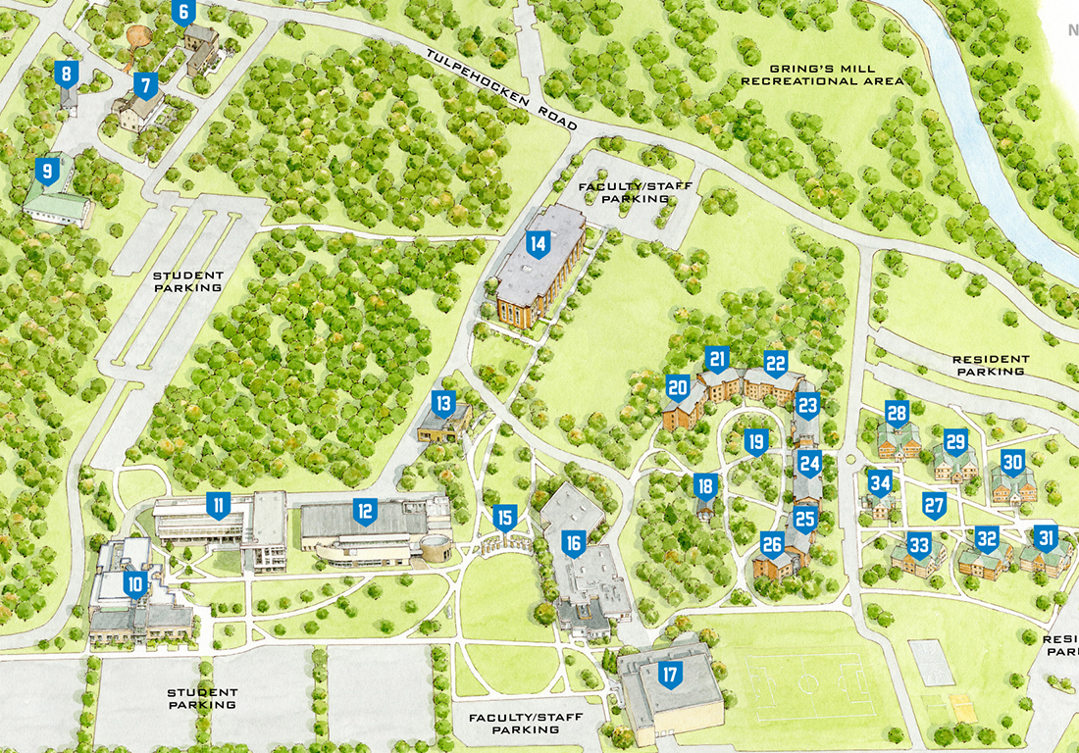
Geothermal Depth Initial Motivation
Large open space
Potential energy savings
Potential emissions reductions
Life-costs of system
Open area surrounding Gaige Building
Overview
Existing Conditions
Geothermal Depth
System Alternatives
Energy & Emissions
Life Cycle Cost Analysis
Acoustics
Onsite Measurements
Heat Pumps
Campus-wide Geothermal
Conclusions
The Gaige Building

Slide 8
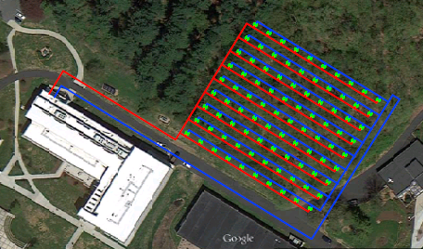
Geothermal Depth Alternative 1: Vertical Loop System
23,636 feet of well required
100 required vertical wells
  20% safety
  300’ well depth
  Costs per well - $3,714.25
To next bore
Overview
Existing Conditions
Geothermal Depth
System Alternatives
Energy & Emissions
Life Cycle Cost Analysis
Acoustics
Onsite Measurements
Heat Pumps
Campus-wide Geothermal
Conclusions
To previous
bore
1 inch HDPE
piping
Bentonite
backfill
300 feet
Required Number of Vertical Bores
Well Depth | Required Bore Length | # of Wells | # of Wells, 20% Saftey
100 | 23636.4 | 237 | 284
200 | 23636.4 | 119 | 142
300 | 23636.4 | 79 | 95
400 | 23636.4 | 60 | 71
6 in.

Slide 9
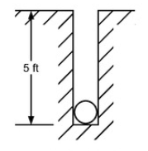
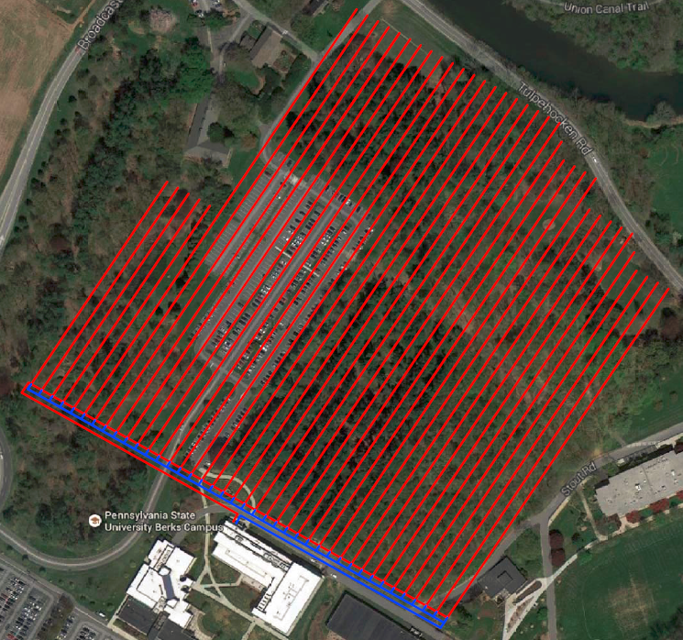
Geothermal Depth Alternative 2: Horizontal Loop System
28,550 ft. of horizontal loops
  Based on 20% safety
  Cost per 300’: $3,435.62
Overview
Existing Conditions
Geothermal Depth
System Alternatives
Energy & Emissions
Life Cycle Cost Analysis
Acoustics
Onsite Measurements
Heat Pumps
Campus-wide Geothermal
Conclusions
Required Number of Horizontal Loops
Loop Length | Number of Loops | Total Length
800 | 20 | 16000
775 | 1 | 775
750 | 4 | 3000
700 | 5 | 3500
675 | 1 | 675
650 | 4 | 2600
400 | 5 | 2000
 | Total Length | 28550

Slide 10
Geothermal Depth Alternative Cost Comparisons
Increased first costs:
  Savings from original design
  Added geothermal costs
  Time & Location adjustments
Overview
Existing Conditions
Geothermal Depth
System Alternatives
Energy & Emissions
Life Cycle Cost Analysis
Acoustics
Onsite Measurements
Heat Pumps
Campus-wide Geothermal
Conclusions
Horizontal - Increased First-Costs
Cost Item | Amount
Increased First Cost - General | $ 601,959.52
Location Multiplier - Reading PA | 0.988
Increased First Cost - Reading | $ 594,736.01
Savings from Original Design - 2009 | $ 484,710.00
Time Multiplier - 2014 to 2009 | 0.889
Savings from Original Design - 2014 | $ 545,230.60
Overall First Cost Increase: | $ 49,505.41
Vertical - Increased First-Costs
Cost Item | Amount
Increased First Cost - General | $ 655,736.06
Location Multiplier - Reading PA | 0.988
Increased First Cost - Reading | $ 647,867.23
Savings from Original Design - 2009 | $ 484,710.00
Time Multiplier - 2014 to 2009 | 0.889
Savings from Original Design - 2014 | $ 545,230.60
Overall First Cost Increase: | $ 102,636.63

Slide 11
Geothermal Depth Annual Emissions Reductions
Little change in emissions
  Decreased natural gas emissions
  Increased electricity emissions
Overview
Existing Conditions
Geothermal Depth
System Alternatives
Energy & Emissions
Life Cycle Cost Analysis
Acoustics
Onsite Measurements
Heat Pumps
Campus-wide Geothermal
Conclusions
Difference in Total Annual Emissions
Pollutant | Original Emissions (lb/yr) | Geothermal Emissions (lb/yr) | Decrease %
CO2e | 2321124.8 | 2270409.1 | 2.18%
CO₂ | 2194071.2 | 2140470.1 | 2.44%
CH4 | 4526.3 | 4661.8 | -2.99%
NOx | 3896.3 | 3905.4 | -0.23%
SOx | 10799.6 | 11128.1 | -3.04%
CO | 1173.6 | 1117.3 | 4.80%
Solid Waste | 258316.8 | 266191.0 | -3.05%

Slide 12
Geothermal Depth Annual Energy Savings
Almost eliminated natural gas consumption
Similar annual electricity consumption
  Heat pump operation
Annual Energy Savings: $8,494.00
Overview
Existing Conditions
Geothermal Depth
System Alternatives
Energy & Emissions
Life Cycle Cost Analysis
Acoustics
Onsite Measurements
Heat Pumps
Campus-wide Geothermal
Conclusions

Slide 13
Geothermal Depth Life Cycle Cost Analysis
Vertical Well Design:
  Simple: 12.1 years
  Discounted: 12.7 years
Horizontal Loop Design:
  Simple: 5.8 years
  Discounted: 6.1 years
Overview
Existing Conditions
Geothermal Depth
System Alternatives
Energy & Emissions
Life Cycle Cost Analysis
Acoustics
Onsite Measurements
Heat Pumps
Campus-wide Geothermal
Conclusions

Slide 14
Geothermal Depth Alternative Selection
Horizontal Design
  Best Payback – 6.1 years
  Large space requirements
Vertical Design
  Favorable Payback – 12.7 years
  Less space requirements
Overview
Existing Conditions
Geothermal Depth
System Alternatives
Energy & Emissions
Life Cycle Cost Analysis
Acoustics
Onsite Measurements
Heat Pumps
Campus-wide Geothermal
Conclusions

Slide 15
Acoustics Breadth Onsite Measurements
Comparisons to ANSI S12.60
Reverberation Time (T30)
  0.7 for > 10,000 ft³
  0.6 for < 10,000 ft³
Overview
Existing Conditions
Geothermal Depth
System Alternatives
Energy & Emissions
Life Cycle Cost Analysis
Acoustics
Onsite Measurements
Heat Pumps
Campus-wide Geothermal
Conclusions
  Classrooms < 10,000 ft³
  Classrooms > 10,000 ft³

Slide 16
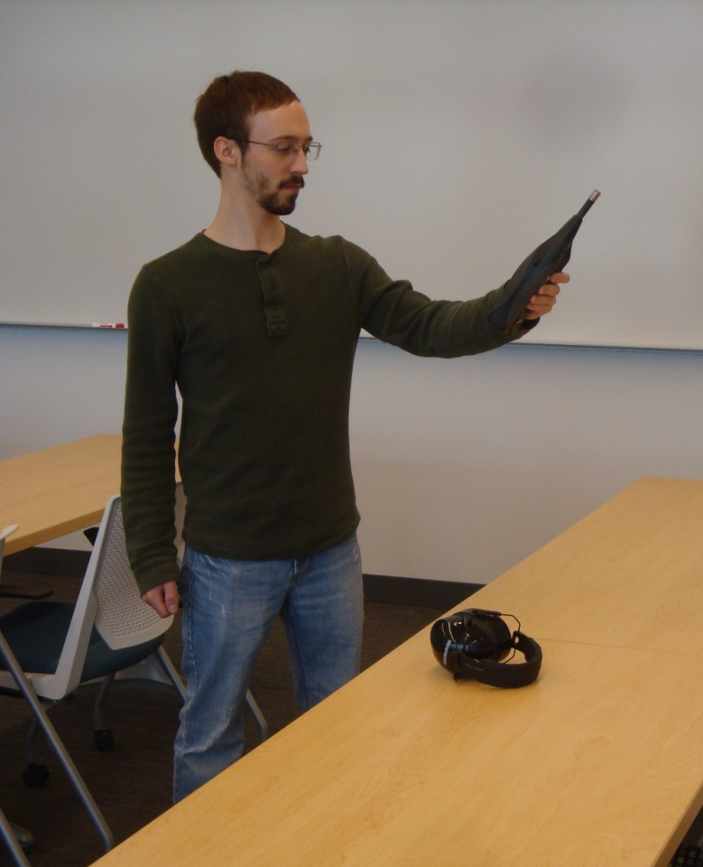
Acoustics Breadth Onsite Measurements
Comparisons to ANSI S12.60
Background Noise Level (BNL)
  NC – 30
Overview
Existing Conditions
Geothermal Depth
System Alternatives
Energy & Emissions
Life Cycle Cost Analysis
Acoustics
Onsite Measurements
Heat Pumps
Campus-wide Geothermal
Conclusions

Slide 17
Acoustics Breadth Onsite Measurements
Comparisons to ANSI S12.60
Transmission Loss (TL) & Sound Trans. Coefficient (STC)
  STC – 50 between classrooms
Overview
Existing Conditions
Geothermal Depth
System Alternatives
Energy & Emissions
Life Cycle Cost Analysis
Acoustics
Onsite Measurements
Heat Pumps
Campus-wide Geothermal
Conclusions
  Classroom 121 to 122, 49 ASTC
  Classroom 120 to 121, 46 ASTC

Slide 18
Acoustics Breadth Onsite Measurements
Comparisons to ANSI S12.60
Transmission Loss (TL) & Sound Trans. Coefficient (STC)
  STC – 50 between classrooms
Overview
Existing Conditions
Geothermal Depth
System Alternatives
Energy & Emissions
Life Cycle Cost Analysis
Acoustics
Onsite Measurements
Heat Pumps
Campus-wide Geothermal
Conclusions
  Classroom 247 to 248, 38 ASTC
  Classroom 246 to 247, 40 ASTC

Slide 19
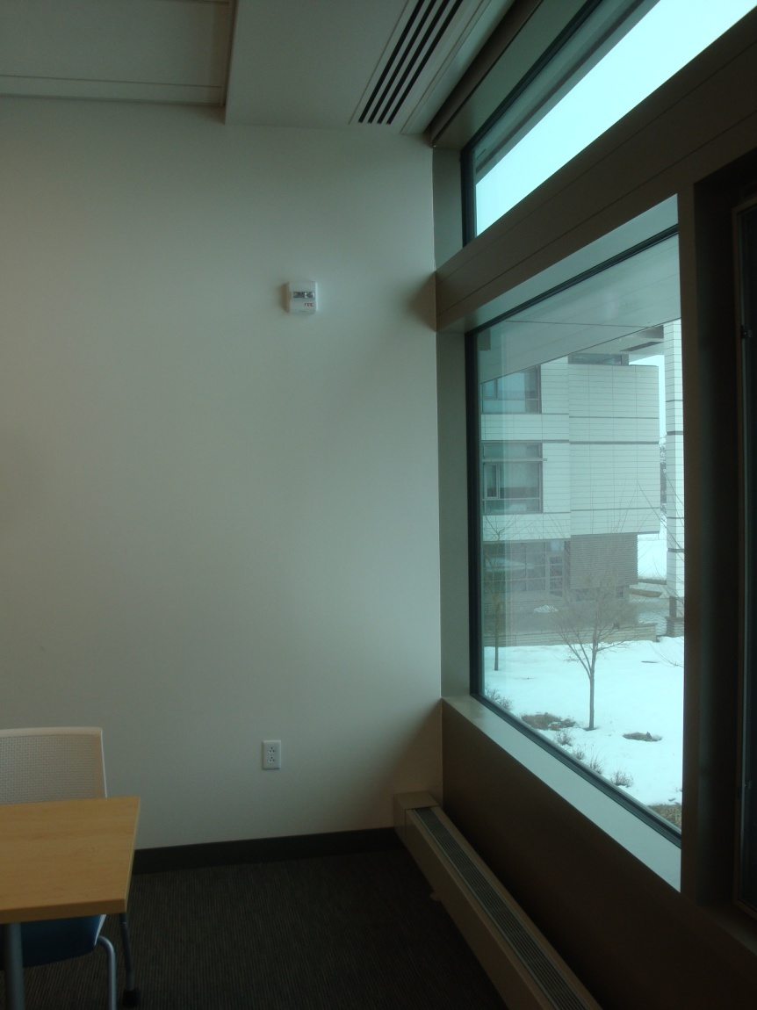
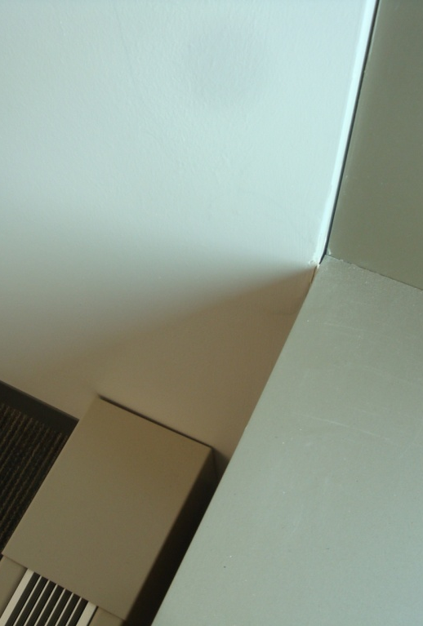
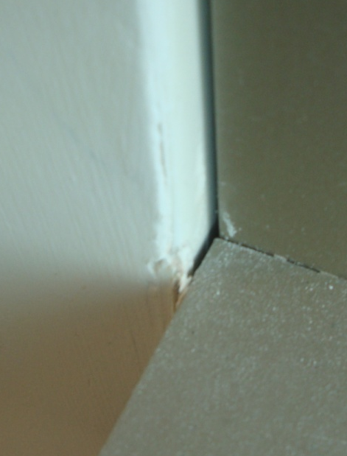
Acoustics Breadth Onsite Measurements
Overview
Existing Conditions
Geothermal Depth
System Alternatives
Energy & Emissions
Life Cycle Cost Analysis
Acoustics
Onsite Measurements
Heat Pumps
Campus-wide Geothermal
Conclusions
  Classroom 247 to 248, 38 ASTC

Slide 20

Acoustics Breadth Heat Pump Sound Isolation
Option 1: ceiling plenum
Classroom & heat pump modeled in Odeon
  Inadequate background noise level
  ~ 50 to 55 dBA
Option 2: mechanical room
  Meets 35 dBA criteria
  ~ 20 to26 dBA
Overview
Existing Conditions
Geothermal Depth
System Alternatives
Energy & Emissions
Life Cycle Cost Analysis
Acoustics
Onsite Measurements
Heat Pumps
Campus-wide Geothermal
Conclusions

Slide 21
Acoustics Breadth Heat Pump Ductwork Noise Control
Private Offices & Classrooms
  Specify minimum lengths of duct lining
Overview
Existing Conditions
Geothermal Depth
System Alternatives
Energy & Emissions
Life Cycle Cost Analysis
Acoustics
Onsite Measurements
Heat Pumps
Campus-wide Geothermal
Conclusions
  Offices
  Classrooms
Minimum Duct Lining Lengths
Path | Private Office | Classroom
Supply | 2 feet | 3 feet
Return | 3 feet | 5 feet

Slide 22
Campus Geothermal Initial Motivation
Close proximity
All same owner
More space with vertical wells
Potential diversity benefits
Utility usage data known
  Need to know: heating, cooling, and ventilation loads
Overview
Existing Conditions
Geothermal Depth
System Alternatives
Energy & Emissions
Life Cycle Cost Analysis
Acoustics
Onsite Measurements
Heat Pumps
Campus-wide Geothermal
Conclusions

Slide 23
Campus Geothermal Model Validation
Model Validation Performance
Building Name | EIA Targets |  | Model Results |  | Percentage Deviations
 | Electricity (kWh) | Nat. Gas (therms) | Electricity (kWh) | Nat. Gas (therms) | Electricity (kWh) | Nat. Gas (therms)
The Franco Building | 163007 | 7525 | 164693 | 7905 | 1.03% | 5.04%
The Gaige Building | 223701 | 11643 | 226577 | 11816 | 1.29% | 1.49%
Thun Library | 330557 | 7041 | 331394 | 7089 | 0.25% | 0.69%
Luerssen Building | 800746 | 0 | 800627 | 0 | 0.01% | n/a
Janssen Conference Center | 101072 | 0 | 100504 | 0 | 0.56% | n/a
Perkins Student Center | 593073 | 0 | 592461 | 0 | 0.10% | n/a
Beaver Community Center | 176622 | 5607 | 177305 | 5338 | 0.39% | 4.79%
Hintz Bookstore | 31168 | 0 | 31800 | 0 | 2.03% | n/a
All Campus Residences | 455342 | 0 | 458615 | 0 | 0.72% | n/a
Overview
Existing Conditions
Geothermal Depth
System Alternatives
Energy & Emissions
Life Cycle Cost Analysis
Acoustics
Onsite Measurements
Heat Pumps
Campus-wide Geothermal
Conclusions
2003 EIA building energy use survey used
End use energy percentages estimated
Trace model created for each building
Validated to utility and EIA percentage estimates

Slide 24
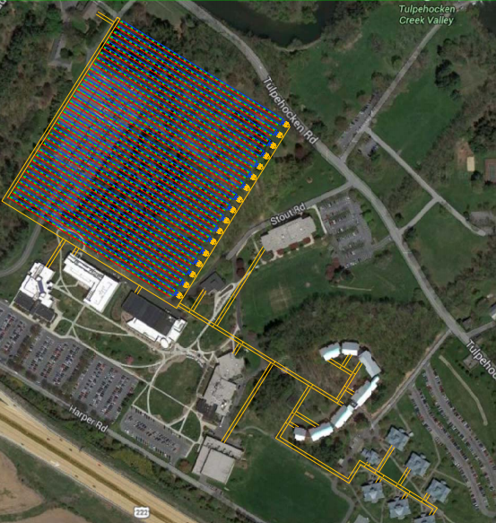
Campus Geothermal Sizing and Layout
463,653 feet of wells required
500’ well depth used
1020 wells minimum
  1050 wells chosen
Overview
Existing Conditions
Geothermal Depth
System Alternatives
Energy & Emissions
Life Cycle Cost Analysis
Acoustics
Onsite Measurements
Heat Pumps
Campus-wide Geothermal
Conclusions
To next bore
To previous
bore
1 inch HDPE
piping
Bentonite
backfill
500 feet
6 in.

Slide 25
Campus Geothermal Annual Energy Savings
Baseline and geothermal models created
  Annual Energy Savings: $58,166.00
~ 27.2 % reduction in emissions
Overview
Existing Conditions
Geothermal Depth
System Alternatives
Energy & Emissions
Life Cycle Cost Analysis
Acoustics
Onsite Measurements
Heat Pumps
Campus-wide Geothermal
Conclusions
Difference in Total Annual Emissions
Pollutant | Original Design Total Emissions (lb/yr) | Geothermal Design Total Emissions (lb/yr) | Percent Decrease %
CO2e | 15258985.5 | 11108037.4 | 27.20%
CO₂ | 14405155.4 | 10489303.8 | 27.18%
CH4 | 30525.2 | 22104.3 | 27.59%
N₂O | 338.5 | 246.3 | 27.24%
NO_{x} | 25923.5 | 18824.4 | 27.38%
SO_{x} | 72849.1 | 52749.9 | 27.59%
CO | 7614.6 | 5558.6 | 27.00%
PM10 | 819.1 | 597.2 | 27.10%
Solid Waste | 1742541.0 | 1261763.3 | 27.59%

Slide 26
Campus Geothermal Life Cycle Cost Analysis
Building | Required Bores
The Gaige Building | 48
The Franco Building | 109
The Thun Library | 173
The Hintz Bookstore | 4
The Beaver Community Commons | 122
The Perkins Student Center | 202
The Janneson Conference Center | 37
The Luerssen Building | 284
All Campus Residences | 58
Total Bores for Campus, separate | 1038
Total Bores for Campus, together | 928
Diversity Realized | 89.4%
Overview
Existing Conditions
Geothermal Depth
System Alternatives
Energy & Emissions
Life Cycle Cost Analysis
Acoustics
Onsite Measurements
Heat Pumps
Campus-wide Geothermal
Conclusions
Increased first costs estimated
  $6,358,220.94 increase
No reasonable payback period was found
  Very high increased first costs
  No savings realized from other buildings
Relatively small amount of diversity
  ~ 89.4% overall
Campus - Increased First-Costs
Cost Item | Amount
Increased First Cost - Building Costs | $ 1,252,778.74
Increased First Cost – Well Field Costs | $ 5,734,520.38
Location Multiplier - Reading PA | 0.988
Increased First Cost - Reading | $ 6,903,451.53
Savings from Original Design - 2009 | $ 484,710.00
Time Multiplier - 2014 to 2009 | 0.889
Savings from Original Design - 2014 | $ 545,230.60
Overall First Cost Increase: | $ 6,358,220.94

Slide 27
Campus Geothermal Life Cycle Cost Analysis
Simple Payback with 10% Safety Factor
Load Diversity | Bores: 10% Safety | First Cost Increase | Simple Payback
100% | 1142 | $ 6,185,478.68 | 82.64
95% | 1085 | $ 5,906,080.61 | 78.90
90% | 1028 | $ 5,626,682.53 | 75.17
85% | 971 | $ 5,347,284.45 | 71.44
80% | 914 | $ 5,067,886.37 | 67.70
75% | 857 | $ 4,788,488.30 | 63.97
70% | 800 | $ 4,509,090.22 | 60.24
65% | 743 | $ 4,229,692.14 | 56.51
60% | 686 | $ 3,950,294.06 | 52.77
55% | 628 | $ 3,665,994.26 | 48.98
50% | 571 | $ 3,386,596.19 | 45.24
Actual Building | 1050 | $ 5,734,520.38 | 76.61
Savings Comparison – With Current Safety Factor
Increased Savings ($) | New First Cost | Simple Payback | Discounted Payback
Current Design | $ 5,734,520.38 | 76.61 | > 40 years
$ 1,000,000.00 | $ 4,734,520.38 | 63.25 | > 40 years
$ 3,000,000.00 | $ 2,734,520.38 | 36.53 | > 40 years
$ 4,000,000.00 | $ 1,734,520.38 | 23.17 | > 40 years
$ 4,400,000.00 | $ 1,334,520.38 | 17.83 | 30.11
$ 4,500,000.00 | $ 1,234,520.38 | 16.49 | 25.02
$ 4,600,000.00 | $ 1,134,520.38 | 15.16 | 21.56
$ 4,800,000.00 | $ 934,520.38 | 12.48 | 16.34
$ 5,000,000.00 | $ 734,520.38 | 9.81 | 12.21
$ 5,200,000.00 | $ 534,520.38 | 7.14 | 8.68
$ 5,500,000.00 | $ 234,520.38 | 3.13 | 4.10
Overview
Existing Conditions
Geothermal Depth
System Alternatives
Energy & Emissions
Life Cycle Cost Analysis
Acoustics
Onsite Measurements
Heat Pumps
Campus-wide Geothermal
Conclusions
Effect of increased diversity
  Poor payback period with high diversity
  Not justifiable
Effect of increased initial savings
  Feasible payback with $4.5 million initial savings
  Savings from new buildings
  Savings from renovation alternatives for buildings

Slide 28

Final Conclusions Gaige Building and Campus Geothermal
Both vertical and horizontal designs feasible
  Horizontal system cheaper – 6.1 years
  Vertical system less space constraints – 12.7 years
Heat pump noise control
  Isolated through partition design
  Isolated from minimum duct lining lengths
Gaige Building compared with ANSI S12.60
  Meets requirements for RT and BNL
  Some partitions do not meet STC requirements
Campus-wide geothermal
  Not reasonable payback
  Less diversity found in campus load
  Initial savings are needed
Overview
Existing Conditions
Geothermal Depth
System Alternatives
Energy & Emissions
Life Cycle Cost Analysis
Acoustics
Onsite Measurements
Heat Pumps
Campus-wide Geothermal
Conclusions

Slide 29
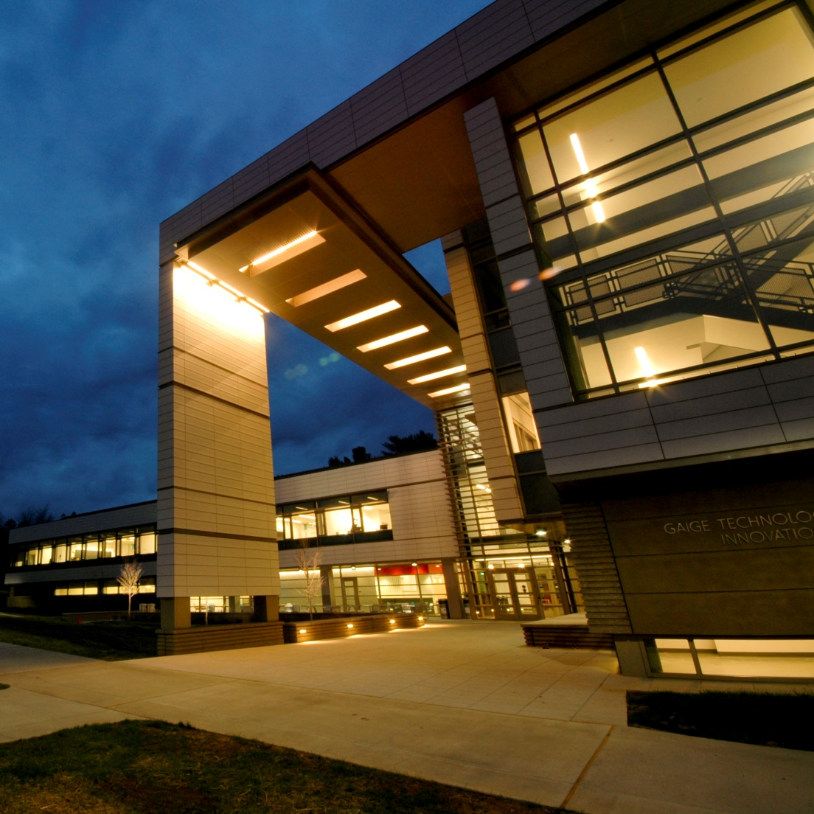

Final Conclusions Acknowledgements
Special thanks to:
  Scott Mack & Justin Kalanesh, H. F. Lenz
  Kim Berry, Penn State Berks
  Dr. Stephen Treado, adviser
  Dr. Richard Mistrick, honors adviser
  Moses Ling
  Dr. Michelle Vigeant
  Aaron King and Cory Clippinger
  Photos courtesy of Penn State Berks and Illumination Arts
Overview
Existing Conditions
Geothermal Depth
System Alternatives
Energy & Emissions
Life Cycle Cost Analysis
Acoustics
Onsite Measurements
Heat Pumps
Campus-wide Geothermal
Conclusions

Slide 30
Thank You!
Matthew Neal
Mechanical Option
Dr. Stephen Treado, Adviser

Slide 31
Appendix Slides Existing Conditions

Slide 32
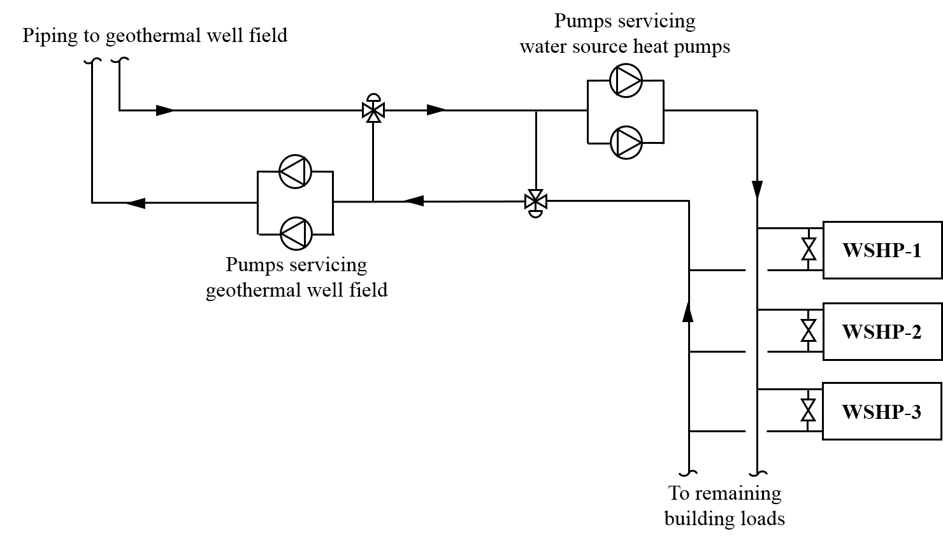
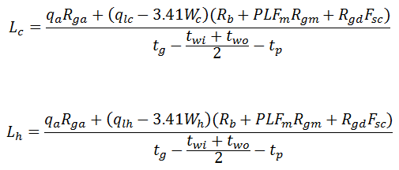
Appendix Slides Gaige Geothermal
Geothermal Design
Parameter | Heating | Cooling
Short-Circuit Factor (F_{sc}) | 1.04 | 1.04
Part-Load Factor (PLF_{m}) | 1 | 1
Average Heat Transfer to Ground (q_{a}) | 387000 | 387000
Block Loads (q_{lc} and q_{lh}) | 679400 | 1066400
Resistance of Ground, Annual pulse (R_{ga}) | 0.215 | 0.215
Resistance of Ground, Daily pulse (R_{gd}) | 0.129 | 0.129
Resistance of Ground, Monthly pulse (R_{gm}) | 0.207 | 0.207
Resistance of Bore (R_{b}) | 0.09 | 0.09
Undisturbed Ground Temperature (tg) | 53 | 53
Temperature Penalty for Bore Spacing (t_{p}) | 1.8 | 1.8
Heat Pump Inlet Temperature (t_{wi}) | 38 | 78
Heat Pump Outlet Temperature (t_{wo}) | 33 | 85
System Power Input (W_{c} and W_{h}) | 3728.5 | 3728.5
Required Bore Length (L_{c} and L_{h}) | 23636.4 | 17760.4

Slide 33
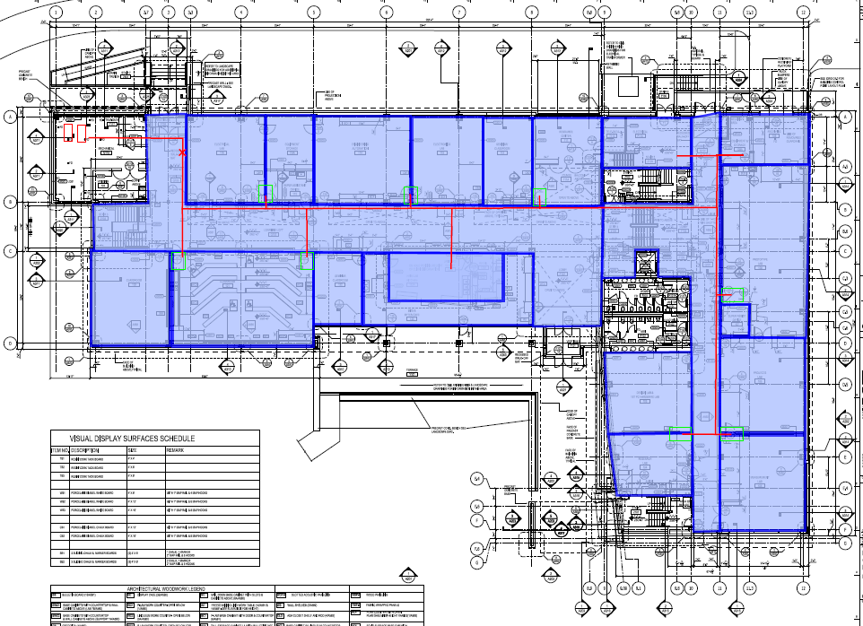
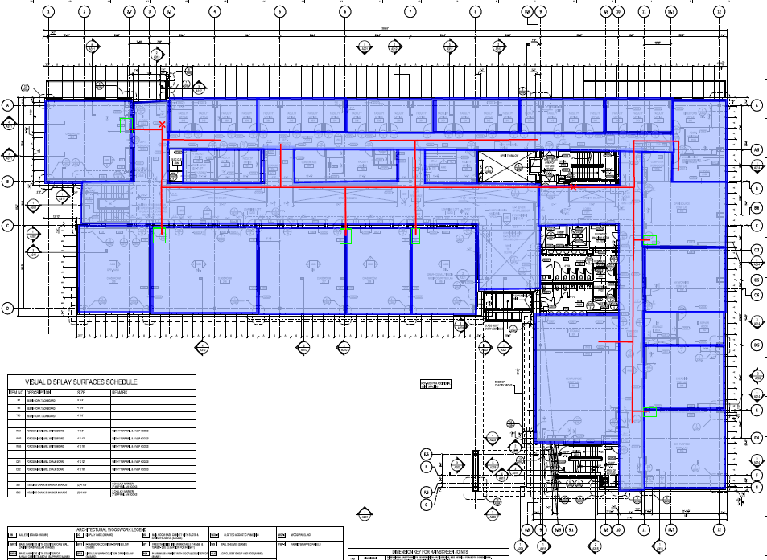
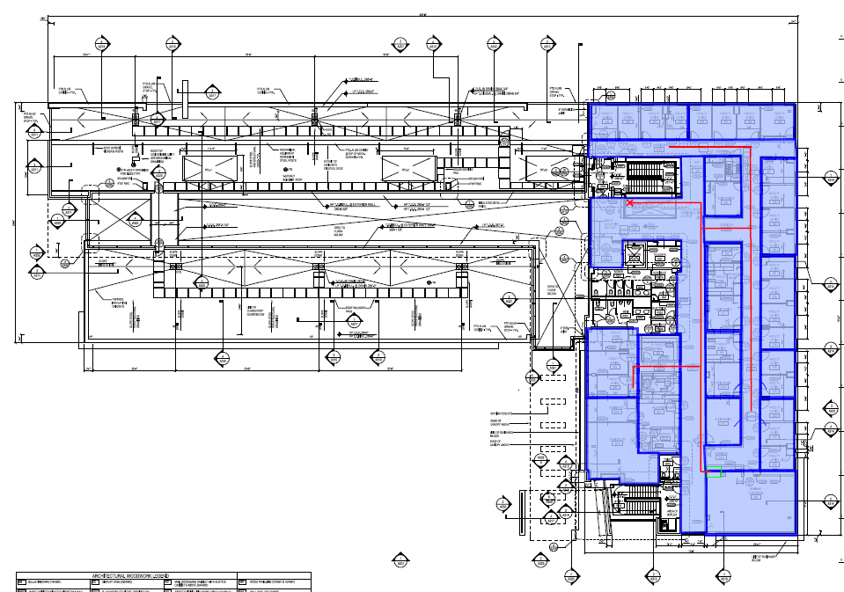

Appendix Slides Gaige Geothermal

Slide 34
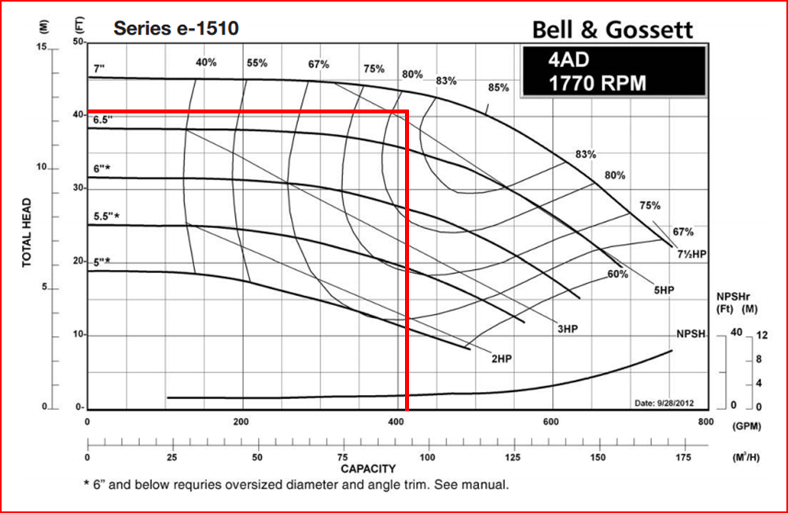
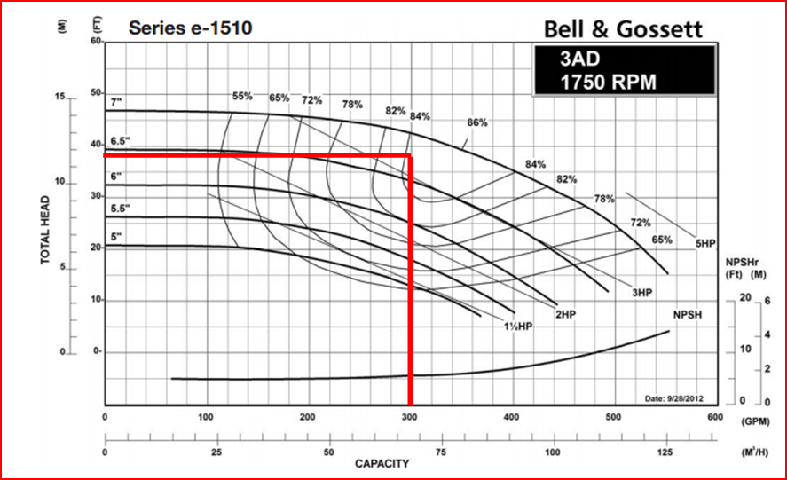
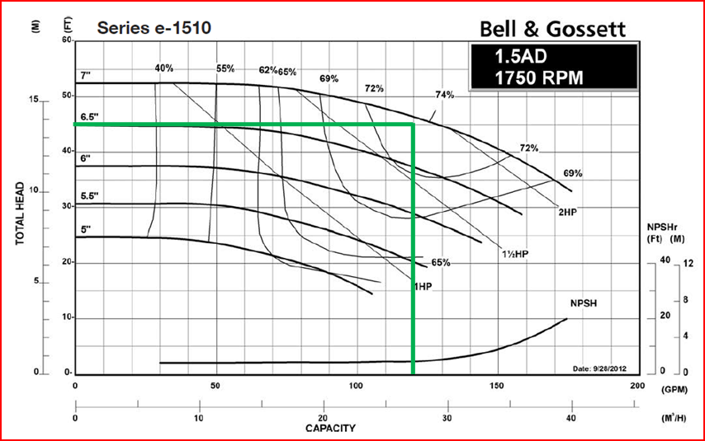
Appendix Slides Gaige Geothermal
Building Pump
Vertical Pump
Horizontal Pump

Slide 35
Appendix Slides Gaige Geothermal
Vertical Geothermal Additional First Costs-Cost Per Pile
Item |  | Unit Cost |  |  |  | Amount | Units | Expense
 |  | Materials | Labor | Equipment | Total
Pile Boring and Filling |  | $ 1.09 | $ 5.28 | $ 3.92 | $ 10.29 | 300 | VLF | $ 3,088.41
1" HDP Pipe |  | $ 0.79 | $ - | $ - | $ 0.79 | 600 | LF | $ 474.00
1" HDP Elbow |  | $ 5.60 | $ - | $ - | $ 5.60 | 4 | Each | $ 22.40
1" HDP Joints |  | $ - | $ 5.55 | $ - | $ 5.55 | 10 | Each | $ 55.50
1" HDP Tee |  | $ 7.30 | $ - | $ - | $ 7.30 | 2 | Each | $ 14.60
Welding Machine |  | $ - | $ - | $ 40.50 | $ 40.50 | 1.47 | Each | $ 59.34
 |  |  |  |  |  |  | Total | $ 3,714.25
Life Cycle Rate Assumptions
Discount Rate | 8.00%
Escalation Rates
Electricity | 3.75%
Natural Gas | 5.00%
Materials | 1.73%
Main. & Labor | 1.73%
Study Period | 20 years

Slide 36
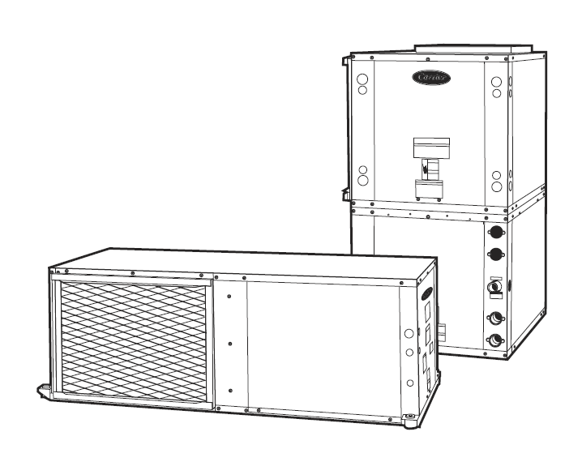
Appendix Slides Gaige Geothermal
Horizontal Geothermal Additional First Costs-Cost Per Pile
Item |  | Unit Cost |  |  |  | Amount | Units | Expense
 |  | Materials | Labor | Equipment | Total
Trenching for piles |  | $ - | $ 0.59 | $ 0.75 | $ 1.34 | 800 | LF | $ 1,073.24
Fill for Trenches |  | $ 4.85 | $ 1.09 | $ 0.41 | $ 6.35 | 800 | LF | $ 5,079.17
Backfill for Trenches |  | $ - | $ 0.61 | $ 0.21 | $ 0.82 | 800 | LF | $ 655.64
Hauling Dirt |  | $ - | $ 0.27 | $ 0.37 | $ 0.63 | 800 | LF | $ 507.37
1" HDP Pipe |  | $ 0.79 | $ - | $ - | $ 0.79 | 1600 | LF | $ 1,264.00
1" HDP Elbow |  | $ 5.60 | $ - | $ - | $ 5.60 | 2 | Each | $ 11.20
1" HDP Joints |  | $ - | $ 5.55 | $ - | $ 5.55 | 49 | Each | $ 271.95
1" HDP Tee |  | $ 7.30 | $ - | $ - | $ 7.30 | 2 | Each | $ 14.60
Welding Machine |  | $ - | $ - | $ 40.50 | $ 40.50 | 1.47 | Days | $ 59.34
 |  |  |  |  |  |  | Total | $ 8,936.51

Slide 37
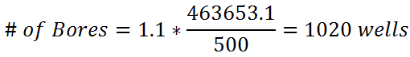
Appendix Slides Campus Geothermal
Campus-wide Geothermal Design
Parameter | Heating | Cooling
Short-Circuit Factor (F_{sc}) | 1.04 | 1.04
Part-Load Factor (PLF_{m}) | 1 | 1
Average Heat Transfer to Ground (q_{a}) | -1390309 | -1390309
Block Loads (q_{lc} and q_{lh}) | 17939009 | 16548700
Resistance of Ground, Annual pulse (R_{ga}) | 0.215 | 0.215
Resistance of Ground, Daily pulse (R_{gd}) | 0.129 | 0.129
Resistance of Ground, Monthly pulse (R_{gm}) | 0.207 | 0.207
Resistance of Bore (R_{b}) | 0.09 | 0.09
Undisturbed Ground Temperature (t_{g}) | 53 | 53
Temperature Penalty for Bore Spacing (t_{p}) | 1.8 | 1.8
Heat Pump Inlet Temperature (t_{wi}) | 38 | 78
Heat Pump Outlet Temperature (t_{wo}) | 33 | 85
System Power Input (W_{c} and W_{h}) | 111855 | 111855
Required Bore Length (L_{c} and L_{h}) | 463653.1 | 220436.7
Energy Multipliers for Electric - Natural Gas Energy Source Buildings
Building Type | Heating |  | Cooling |  | Ventilation
 | Electricity | Nat. Gas | Electricity | Nat. Gas
Office - Mid Atlantic | 5.88% | 54.94% | 9.52% | 4.01% | 9.83%
Classroom - Mid Atlantic | 4.93% | 68.61% | 11.20% | 0.00% | 30.28%
Public Assembly - Mid Atlantic | 1.63% | 54.90% | 4.96% | 38.78% | 51.11%
Classroom / Office Averaged | 5.40% | 61.77% | 10.36% | 2.00% | 20.05%
Public Assembly/Classroom/Office | 4.15% | 59.48% | 8.56% | 14.26% | 30.40%
Public Assembly/Office | 3.75% | 54.92% | 7.24% | 21.39% | 30.47%
Energy Multipliers for Electric only Buildings
Building Type | Heating | Cooling | Ventilation
Office - Mid Atlantic | 27.99% | 7.21% | 6.18%
Public Assembly - Mid Atlantic | 39.95% | 19.08% | 20.98%
Classroom - Mid Atlantic | 50.72% | 4.91% | 13.26%
Lodging - Mid Atlantic | 12.46% | 5.43% | 2.18%
Food Service - Mid Atlantic | 17.51% | 2.98% | 3.69%
Retail - Mid Atlantic | 31.24% | 6.24% | 8.06%
Classroom / Office Averaged | 39.36% | 6.06% | 9.72%
Office/Food Service/Public Assembly | 28.48% | 9.76% | 10.28%

Slide 38
Appendix Slides Campus Geothermal
  Original Campus
  Geothermal Redesign
Background Noise Levels
Room | Overall dBA
Classroom 120 | 32 dBA
Classroom 121 | 31 dBA
Classroom 122 | 29 dBA
Classroom 246 | 32 dBA
Classroom 247 | 31 dBA
Classroom 248 | 28 dBA
Geothermal Cost Savings
Item | Unit Cost | Amount | Units | Savings
RTU's - Quote (20,500, 14,000, 10,725 CFM's) | $ 300,000.00 | 1 | All | $ 300,000.00
RTU Installation | $ 2.00 | 45,230 | CFM | $ 90,460.00
Fin Tubes | $ 75.00 | 1150 | LF | $ 86,250.00
Radiant Heat Panels | $ 100.00 | 80 | Each | $ 8,000.00
 |  |  |  | $ 484,710.00

